Slide 1
What Mitigation and Adaption can we do in Wigan and Leigh?
Notes:
As a result of participating in this lesson you will be able to:
UNDERSTAND how your personal choices affect climate change.
APPLY their knowledge to suggest ways of reducing the impact of climate change

Slide 2
What kind of steps could you take to mitigate the effects of climate change?
Notes:
Introduction / Do Now Task: 10 mins
Ask students to, individually, consider the kind of steps that they could do to mitigate the effects of climate change.
Share a sample of ideas, such as:
Take public transport
Eat/shop locally
Work or cycle more often

Slide 3
How can we manage climate change in Wigan & Leigh?
Strategy to Adopt | Positive Impact Resulting
Public transport
Walking and cycling
Plant-based diet
Renewable energy technologies
Planting trees
Shopping local
Notes:
Starter Task: 15 mins
Working in pairs, ask the students to fill out the table on the Student Activity Sheet, suggesting the positive impacts that can result from changes in behaviour.

Slide 4
How can we manage climate change in Wigan & Leigh?
What changes could you make to reduce air pollution and climate change?
Make your pledge!
Notes:
Main Task 1: 15 mins
Ask students to consider and record their ideas on pledge notes about what they can do as individuals to help reduce the negative effects of climate change.

Slide 5
How can Businesses and Governments help?
What should other organisations, such as businesses and governments, do to help reduce the negative impacts of climate change?
Notes:
Main Task 2: 10 mins

Slide 6
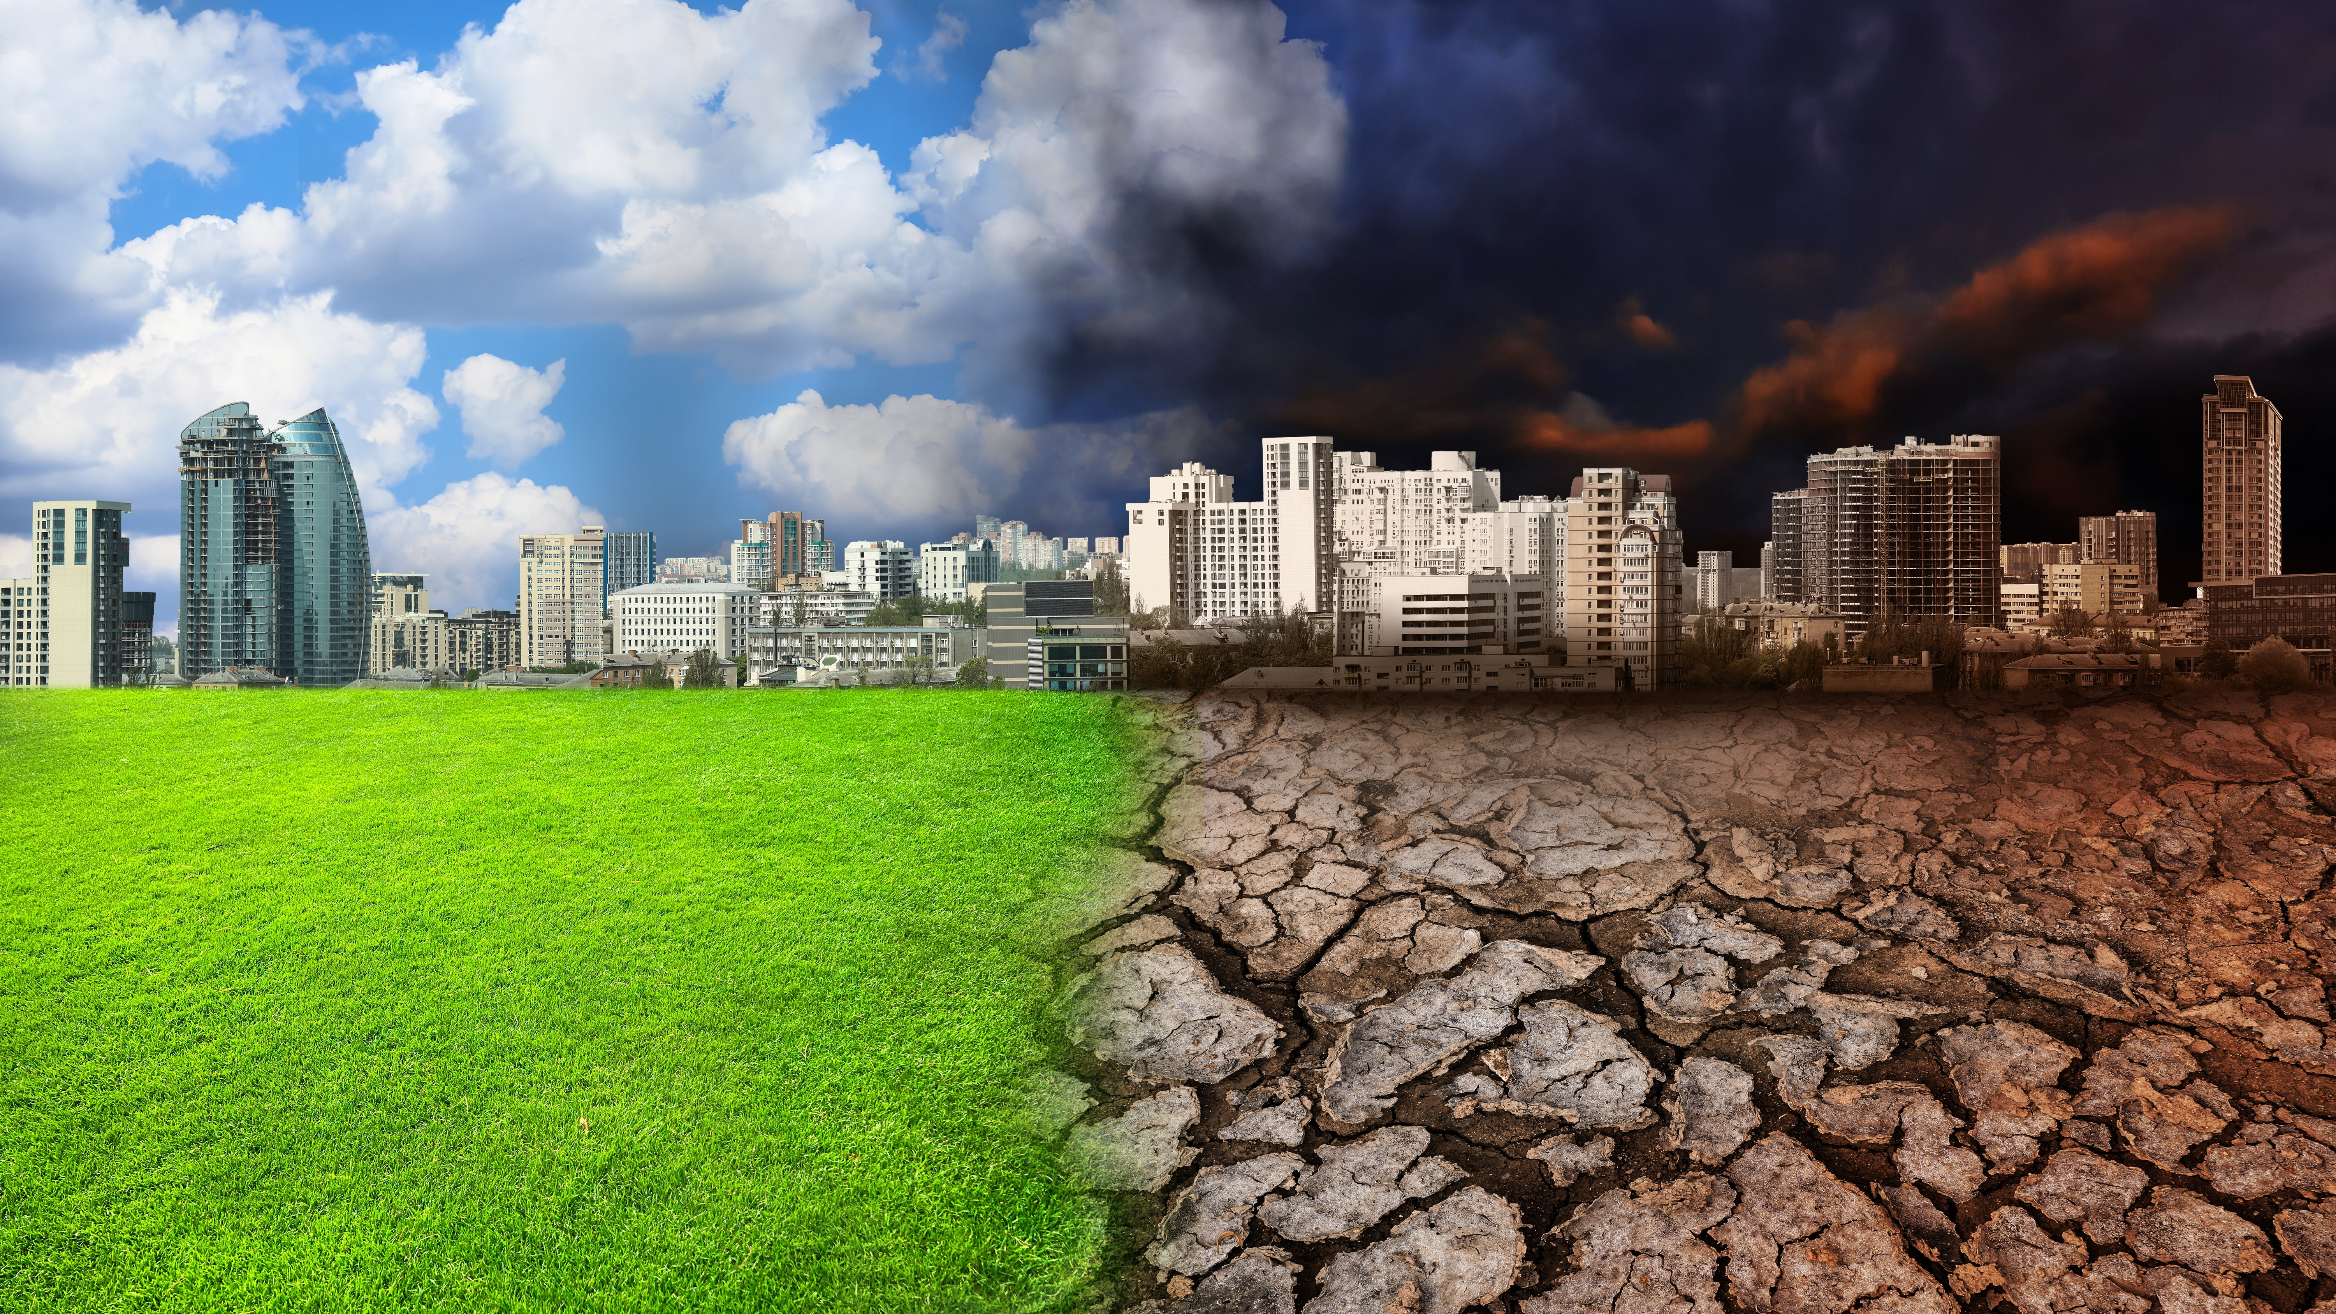
What will your life look like?
Notes:
Plenary: 15 mins

